Slide 1
Spice/K2
History, Research,
Other States Recent Actions Against

Slide 2
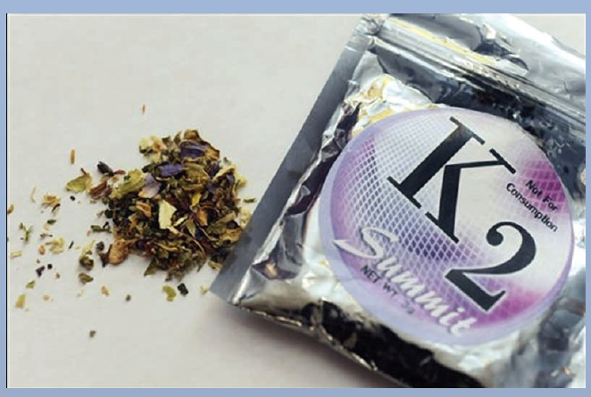
What is Spice/K2?
“Legal Marijuana”
Mixture of herbal
and spice plant
products that are
sprayed or soaked with
synthetic cannabinoids
Marketed as incense and
“not for human consumption”, sold in smoke shops
BUT, has recently spiked in popularity as a product to be smoked, usually resulting in a high similar to marijuana
Also packaged as: K2, Ultra, Summit, Blonde, Standard, Yucatan Gold, Genie, Pot-pourri, Bombay Blue, plus many others

Slide 3
Is it Legal?
Yes, in Idaho and 39 other states
DEA has labeled it a “drug and chemical of concern”
Anyone can buy the product, unless you are in one of the states that have recently banned it
“…it would be like sending my 10 year old son into Wal-Mart to buy potpourri.”
Do not technically have to be 18 to buy it unless:
Smoke shop has age restrictions to enter
Online purchasing restrictions

Slide 4
History
Dr. John Huffman, Clemson University, organic chemistry professor
Was researching effects of cannabinoids on the brain when his work resulted in a 1995 paper that contained the methods and ingredients used to make the compound (JWH-018, his initials)
Was synthesizing analogues and metabolites of THC, the principle active component of marijuana, for research purposes
“Apparently someone picked it up, I think in Europe, on the idea of doping this incense mixture with the compound and smoking it” –Dr. Huffman

Slide 5
What are synthetic cannabinoids?
Structurally diverse class of mostly synthetic substances that bind to cannabinoid receptors in the brain
CB1, CB2 receptors primarily affect the central nervous system
JWH-018
JWH-073
HU-210
HU-211
CP47,497
There are around 100 known synthetic cannabinoids, approx.10 of them have been recently found in spice-like products

Slide 6
Why smoke Spice?
Many users express their experience as a full body high, more intense than marijuana
It is available for anyone to buy at most smoke shops for around $30 for three gram
Comparable in price to marijuana
Doesn’t show up on UA drug tests
Note: Redwood Toxicology lab has recently created a drug test for JWH-018, JWH-073
Buy online in bulk for cheap
You can also purchase pure synthetic cannabinoids online which has been reported to trigger intense hallucinations and LSD-like results

Slide 7
Un-expected Side Effects
“It should not be doing this; it should be doing the opposite…They think they’re going to mellow and that’s not what’s happening”
– Dr. Anthony Scalzo, Saint Louis University
Unlike Marijuana:
Hallucinations and delusions
Blurry vision
Elevated blood pressure
Fast heart beat
Nausea and vomiting
Seizures and loss of consciousness
Much more research is needed!

Slide 8
Unexpected Experience
“ Within less than a minute of smoking K2, Tyler experienced a seizure and became non-responsive…He was almost unconscious for 6 hours…He was on oxygen, his heartbeat was really slow, then it was fast” his father said.
A teenager from Iowa allegedly committed suicide after consuming the substance. He smoked the substance with friends and then began “freaking out” saying he was “going to hell.”

Slide 9
Spice in Idaho
Rocky Mountain Poison and Drug Control Center:
No calls in 2009
Since1/1/2010:
2 calls for information
9 MINOR calls, minimally bothersome symptoms
2 MODERATE calls, more pronounced and prolonged symptoms, some treatment
1 unable to follow, didn’t respond to follow-up call

Slide 10
Why these unexpected results?
The packages are labeled “NOT FOR HUMAN CONSUMPTION”; no regulations are in place and no ingredient list is required
A newer trend is emerging with individuals manufacturing their own synthetic cannabinoids and spraying it on incense or herbal substances

Slide 11
State Ban by Legislation
Synthetic Cannabinoids are currently banned by House or Senate Legislation in eight states, by other measures in three states:
Kansas: HB 2411
Kentucky: HB 265
Georgia: HB1309
Alabama: HB 697
Tennessee: SB 2982/HB 2968
Missouri: HB 1472 ( Enaction: 8/26/10)
Louisiana: HB 173 (Enaction: 8/15/10)
Illinois: HB 4578 (Enaction: 1/1/2011)
Arkansas: Board of Health
North Dakota: Board of Pharm.
Iowa: Board of Pharm.

Slide 12
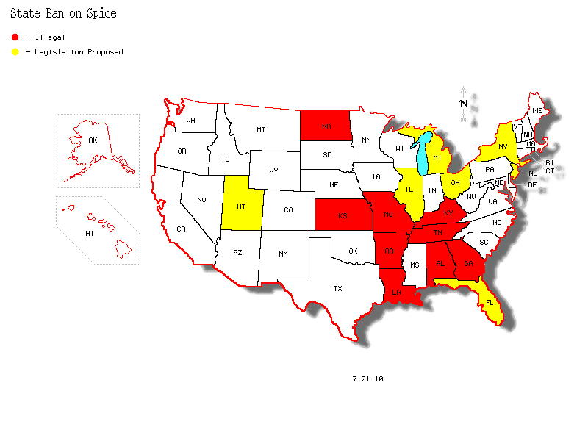
Legislation Proposed
Legislation and discussion has started for the banning of synthetic cannabinoids in:
Florida
Michigan
New York
Utah
Ohio
New Jersey

Slide 13
What exactly did they ban?
 | JWH-018 | JWH-073 | HU-210 | HU-211 | CP47,497 | BZP | TFMPP | Salvia
Kansas | ☒ | ☒ | ☒ |  |  | ☒ | ☒
Kentucky | ☒ | ☒ | ☒ | ☒ | ☒ | ☒ | ☒
Georgia | ☒ | ? | ☒ |  | ☒
Alabama | ☒ | ☒ | ☒ |  |  |  |  | ☒
Tennessee | ☒ | ☒ | ☒ | ☒
Missouri | ☒ | ☒ | ☒ | ☒ | ☒
Louisiana | ☒ | ☒ | ☒ |  | ☒ |  |  | ☒
Arkansas | ☒ | ☒
North Dakota | ☒ | ☒ | ☒ | ☒ | ☒
Illinois | ☒
Iowa

Slide 14
Bill Summary: Added to Schedule I
Adds synthetic cannabinoids to Schedule I of State Controlled Substance List:
North Dakota (2/25/10)
Kansas (3/10/10)
Georgia (5/24/10)
Louisiana (8/15/10)
Missouri (8/26/10)
Illinois (1/1/2011)

Slide 15
Bill Summary: Other
Kentucky (4/13/10): Class A Misdemeanor to manufacture or traffic, Possession is a Class B Misdemeanor
Alabama (4/22/10): Illegal to possess
Tennessee (5/26/10): Class A Misdemeanor
North Dakota (2/25/10): Board of Pharmacy issued an emergency ban
Arkansas (7/2/10): The Board of Health has placed a temporary ban (120 days) on the sale and distribution

Slide 16
Other Restrictions
Many University substance abuse policies cover “chemically related” substances
Currently banned in: Chile, Germany, Finland, Russia, Sweden, France, Ireland, Romania, UK, Switzerland, South Korea, Latvia, Poland, Japan
The Military has banned it use
Some individual counties and cities have taken action against Spice
Suffolk County in New York, banning the sale of certain synthetic cannabinoids to minors in the area

Slide 17
Fiscal Impacts
Alabama
Increase receipts to the State General Fund
Increase obligations dependent on …persons convicted
Louisiana
May result in an increase in state general fund expenditures
May result in an increase in local government expenditures
Kansas
On the state’s inmate population cannot be determined
The Board of Pharmacy states that the bill would have no fiscal impact

Slide 18
Additional Substances added to Bills
Tennessee: Synthetic Cocaine
Kansas and Kentucky: BZP and TFMPP
When combined form a legal alternative to ecstasy
Arkansas and Louisiana: Salvia
A psychoactive plant that can induce dissociative effects
Louisiana:
Additional Plants: Mugwort, Bay bean, Lion’s tail, Lion’s ear, Honey weed, Sacred Lotus, Blue Lotus, Egyptian Lotus, Indian warrior, Dwarf Skullcap, Damiana, Zornia Latifolia
Missouri: 5-MeO-DMT
Natural occurring hallucinogenic drug, analog to DMT

Slide 19
What Next?
Something to think about: Individuals are finding ways to sidestep legislation with a slight alteration to the chemicals structure
Questions and Discussion

